Slide 1

Reliability Testing of iroh-gossip in Realistic Network Environments
Andrea Seehuber
New Trends for Local and Global Interconnects for P2P Applications
University of Basel, 03.12.2025

Slide 2

Recap: The iroh-gossip
P2P protocol for managing neighbourhoods in a dynamic network
list of peers is devided into subsets: active view and passive view
regularly checks active neighbours and replaces from passive list if no longer active
peers randomly exchange entries from their passive views
HyParView (Hybrid Partial View)

Slide 3
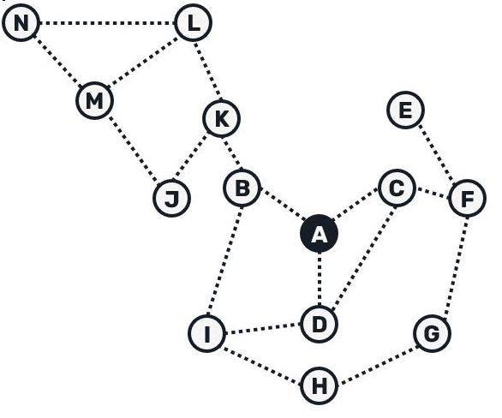
Recap: The iroh-gossip
tow groups of neighbours:
eager peers: receive message immediately
lazy peers: only receive hash of the message
advantages:
high reliability: every node ultimately receives every message
efficiency: only a few messages contain the full content
self-optimising: paths with low latency are used preferentially
PlumTree (Push-Lazy-Update-Multicast)

Slide 4

Recap: The iroh-gossip
Direct
resolving NodeIDs to IP:port via mDNS
Relay
resolving NodeIDs to IP:port via iroh’s public n0 DNS server
useful in small local networks
more reliable peer discovery in big and non-local networks
subscribe_and_join(TopicId, Vec<NodeId>)
method to join a gossip topic
always takes NodeID(s) as argument
at least one bootstrap NodeID has to be known
Discovery

Slide 5

iroh-gossip testing
Possible questions to answer:
How robust is the gossip against network failures, i. e. packet loss, latency, interruptions?
How much does discovery (direct vs. relay) affect delivery rates?
How does the system converge when peers fail or reconnect?
What could be done?

Slide 6
iroh-gossip testing
Possible metrics:
delivery ratio (DR): received vs. sent messages
duplicate rate (DuR): unique received messages
end-to-end-delay (E2E): average delivery time or per message received
convergence time (CT): time until all peers receive all messages
peer reachability (PR): reachable vs. connected peers
reconnect time (RT): time until first received message after reconnect
What could be done?

Slide 7

iroh-gossip testing
Common for all use cases:
each peer is simulated as an isolated Linux network namespace
all peers are connected via a common virtual bridge (acts like a LAN switch)
fixed parameters:
  2000 messages
  10 msg./s
  256 bytes/msg.
  10 repeats per test
variable parameters:
  number of peers (10 – 50)
  number of bootstrap NodeIDs: either exactly 1 or 1 per 10 peers
peer no. 1 acts as sender, all peers run a receiver process
optional network impairments are applied through netem rules (delay, package loss)
all test runs are orchestrated using a common Bash script
Setup

Slide 8
iroh-gossip testing
Use case specific:
Use Case 1/2:
  Discovery mode Direct/Relay
  no network impairments
Use Case 3/4:
  Discovery mode Direct/Relay
  injection of 30 % package loss and 50 ± 5 ms delay per package
  peer no. 1 (sender) is not impaired to guarantee test reproducibility
Use Case 5/6:
  Discovery mode Direct/Relay
  no network impairments
  half of the total peers is disconnected and reconnected after a given time interval
  random choice of disconnected peers
  bootstrap peer is never disconnected for test reproducibility
Setup

Slide 9
iroh-gossip testing
Comments on setup design:
HyParView periodically shuffles peers in the passive view:
  default shuffle interval: 60 s
  test parameters are chosen such that at least 3 shuffles can occur per run
Join success in strongly depends on no. of peers and available bootstraps per test run:
  no. of peers is treated as both an input parameter and an observed metric
  join success is recorded explicitly as an additional metric
Discovery Direct test runs are sensitive to timing and do not tolerate sleeps in the Bash orchestration
Discovery Relay test runs require delay between launching the receiver processes and starting the sender process
Setup

Slide 10

fail rate
test failed if sender didn‘t join topic
fail rate = no. failed runs / no. runs
UC1/UC3: Discovery Direct
UC2/UC4: Discovery Relay
results for exactly 1 bootstrap NodeID
timing problem in setup or Discovery-related?
more bootstrap NodeIDs needed?
no. peers | UC1 | UC2 | UC3 | UC4
10 | 0 % | 0 % | 0 % | 0 %
20 | 10 % | 0 % | 0 % | 0 %
30 | 30 % | 0 % | 0 % | 60 %
40 | 50 % | 0 % | 0 % | 50 %
50 | 60 % | 0 % | 0 % | 40 %
 | no network impairment |  | 50 ms delay, 30 % package loss

Slide 11
fail rate
test failed if sender didn‘t join topic
fail rate = no. failed runs / no. runs
UC1/UC3: Discovery Direct
UC2/UC4: Discovery Relay
results for 1 bootstrap per 10 peers
timing problem in setup or Discovery-related?
no. peers | UC1 | UC2 | UC3 | UC4
10 | 0 % | 5 % | 0 % | 0 %
20 | 0 % | 0 % | 0 % | 60 %
30 | 0 % | 0 % | 0 % | 0 %
40 | 0 % | 0 % | 0 % | 0 %
50 | 5 % | 0 % | 0 % | 10 %
 | no network impairment |  | 50 ms delay, 30 % package loss

Slide 12
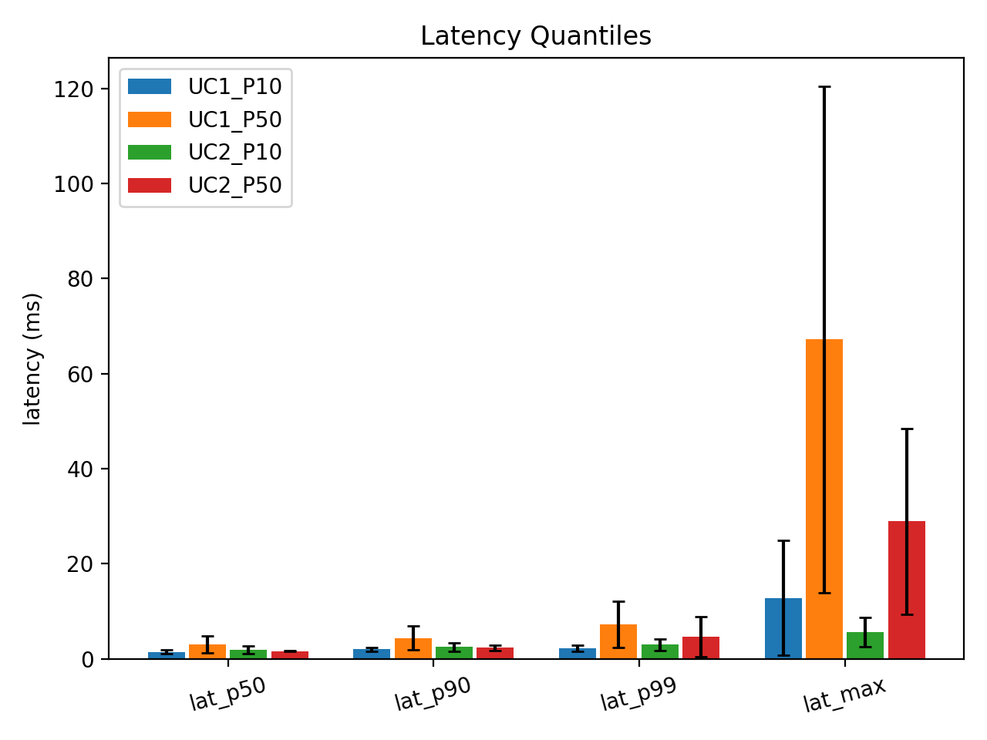
without network impairments
convergence time ≈ 200 s (as expected)
delivery rate ≈ 100 %
no duplicate messages
no out-of-order messages
join ratio for valid runs ≈ 100 %
slightly higher latency for Relay Discovery (not significant)

Slide 13
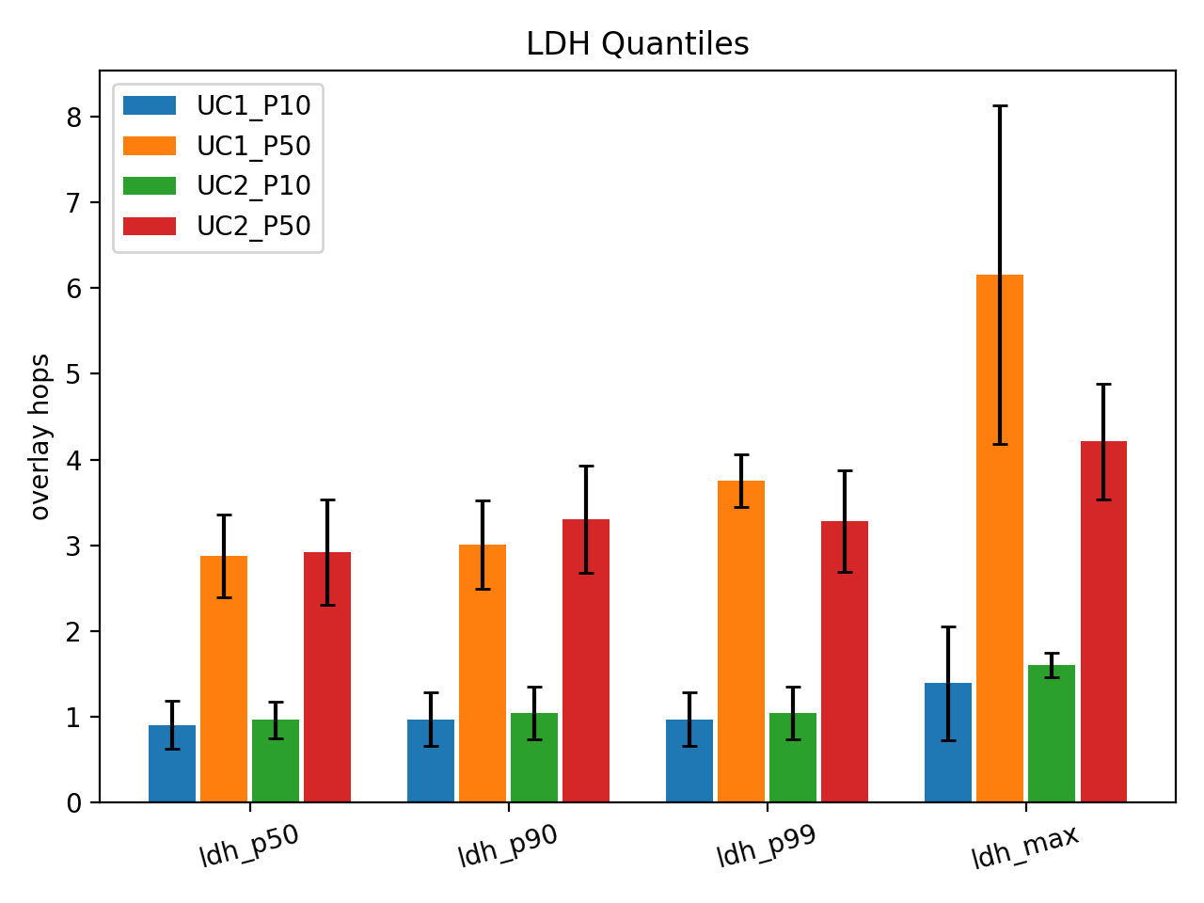
without network impairments
convergence time ≈ 200 s (as expected)
delivery rate ≈ 100 %
no duplicate messages
no out-of-order messages
join ratio for valid runs ≈ 100 %
≈ same no. of node hops for both Discovery modes

Slide 14
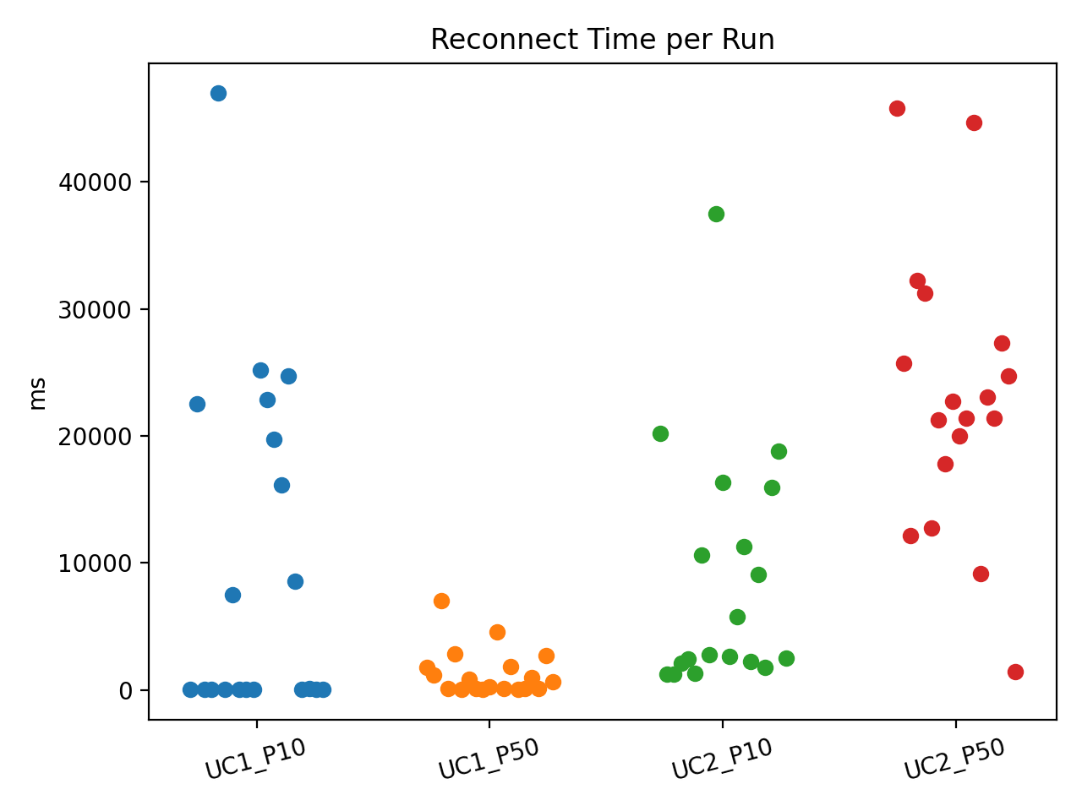
without network impairments
convergence time ≈ 200 s (as expected)
delivery rate ≈ 100 %
no duplicate messages
no out-of-order messages
join ratio for valid runs ≈ 100 %
same no. of reconnect events but longer reconnect times for Relay Discovery
(as expected)

Slide 15
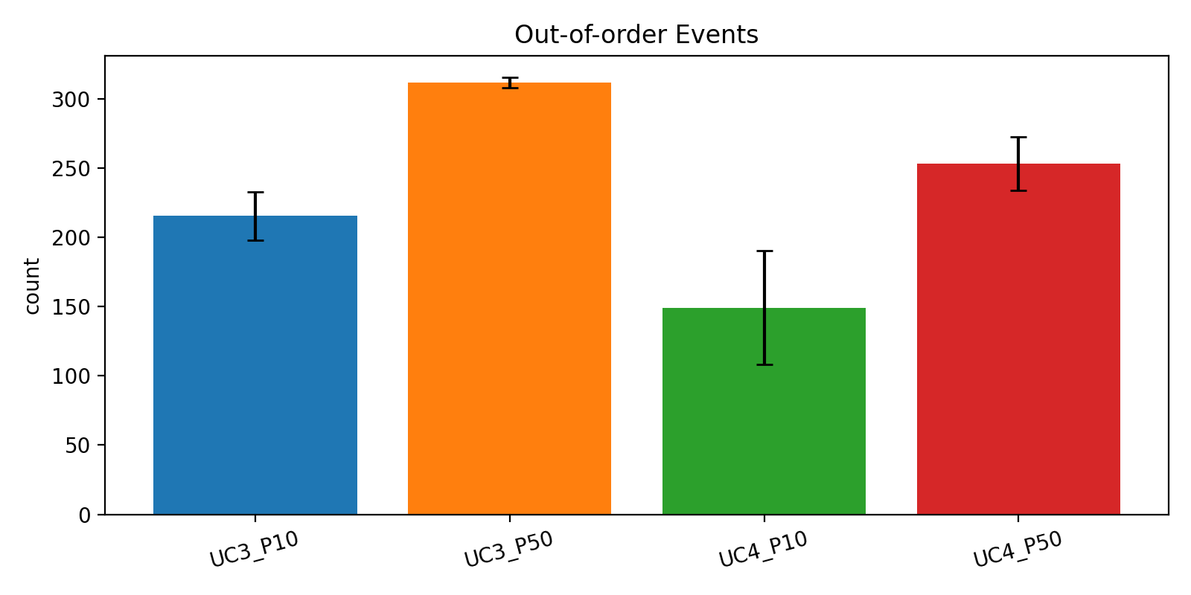
with 50 ms delay and 30 % package loss
convergence time still ≈ 200 s (not expected)
delivery rate still ≈ 100 % (not expected)
no duplicate messages (not expected)
join ratio for valid runs drops to ≈ 80 % for Relay Discovery
latency increases for both Discovery Modes (as expected)
significant no. out-of-order messages

Slide 16
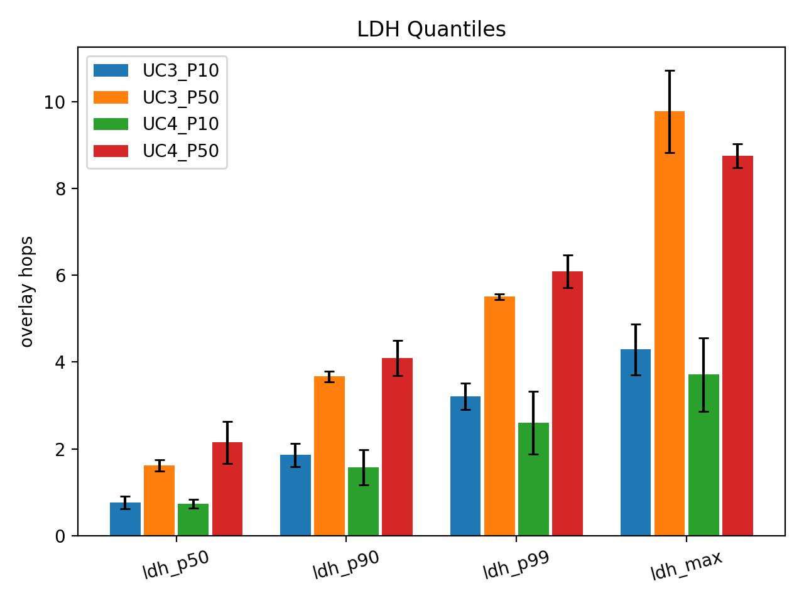
with 50 ms delay and 30 % package loss
convergence time still ≈ 200 s (not expected)
delivery rate still ≈ 100 % (not expected)
no duplicate messages (not expected)
join ratio for valid runs drops to ≈ 80 % for Relay Discovery
latency increases for both Discovery Modes (as expected)
no. of node hops increases but still ≈ same for both Discovery modes

Slide 17
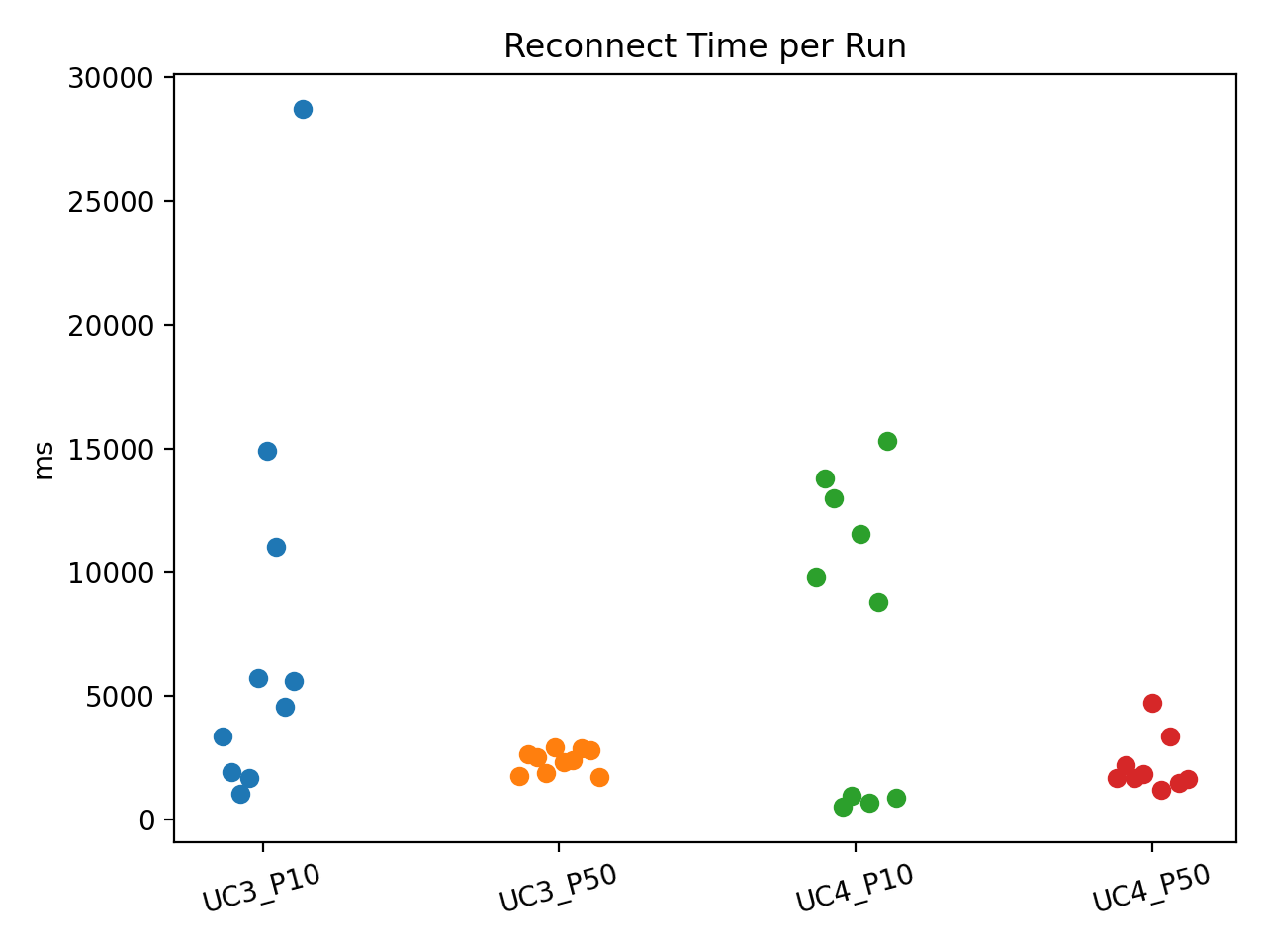
with 50 ms delay and 30 % package loss
convergence time still ≈ 200 s (not expected)
delivery rate still ≈ 100 % (not expected)
no duplicate messages (not expected)
join ratio for valid runs drops to ≈ 80 % for Relay Discovery
latency increases for both Discovery Modes (as expected)
slightly more no. of reconnect events and longer reconnect times for Relay Discovery
(as expected)

Slide 18
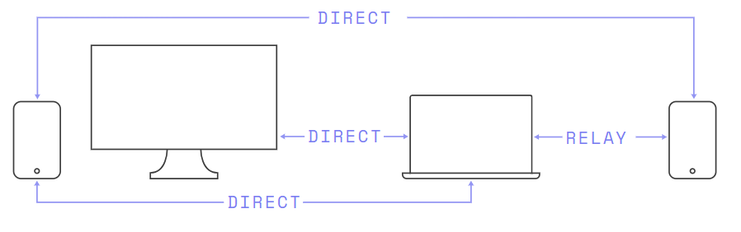

iroh-gossip testing
Disconnect/Reconnect of some peers under Direct/Relay Discovery
(Use Cases 5 and 6) still missing …
What else
could be done?

